Slide 1
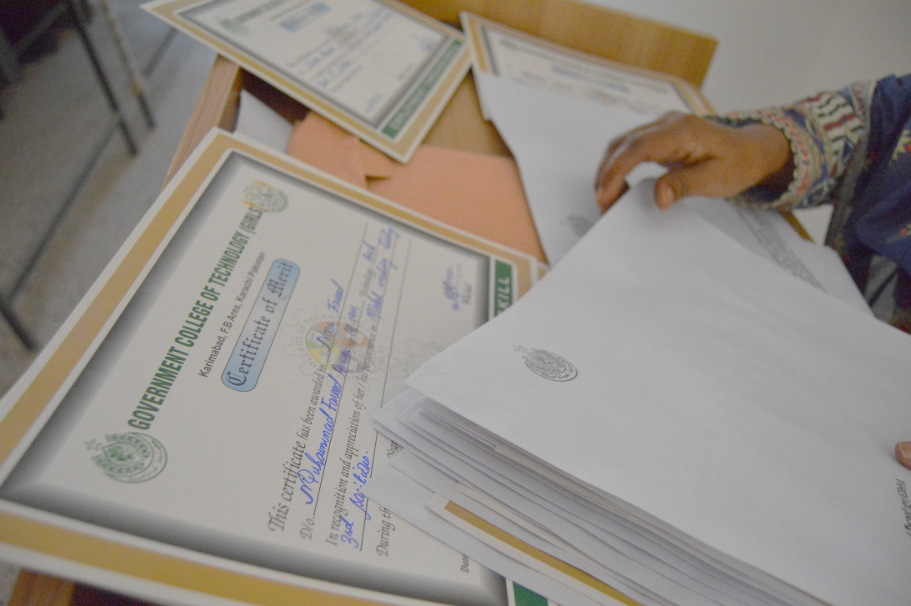
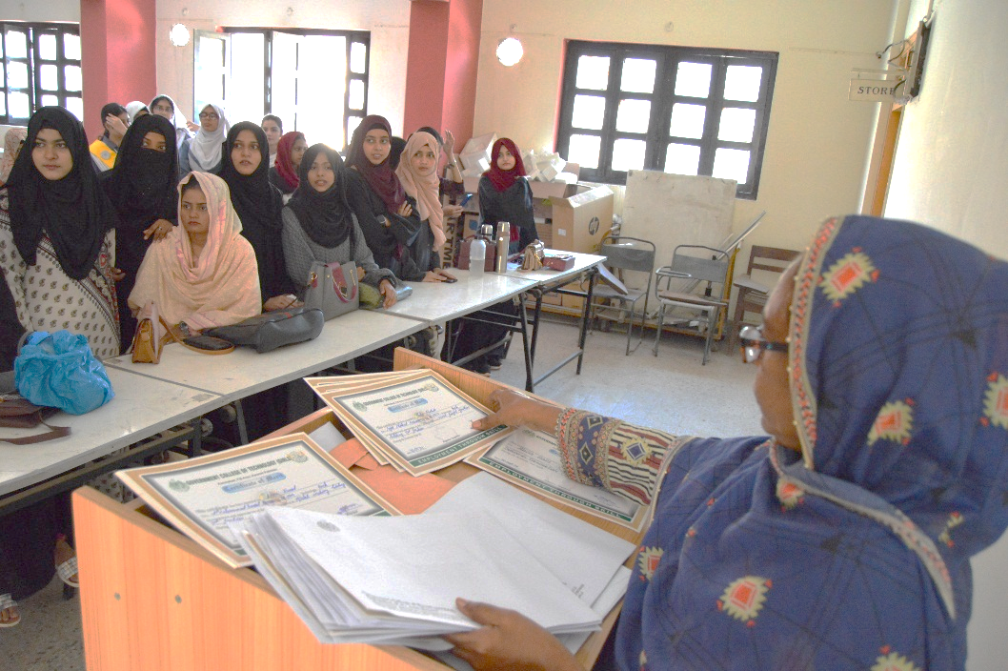
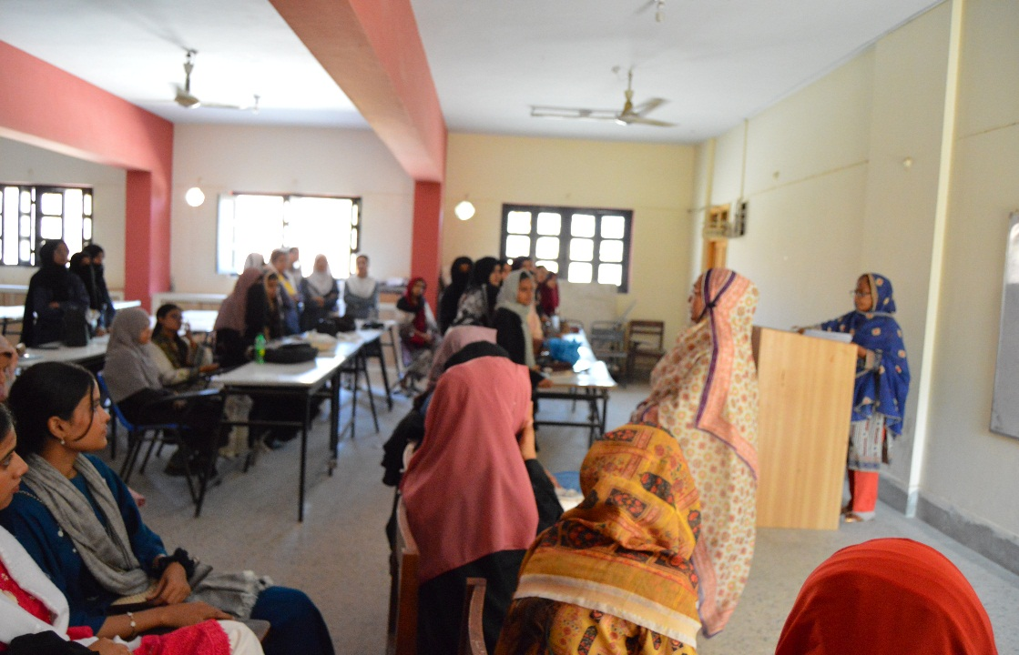
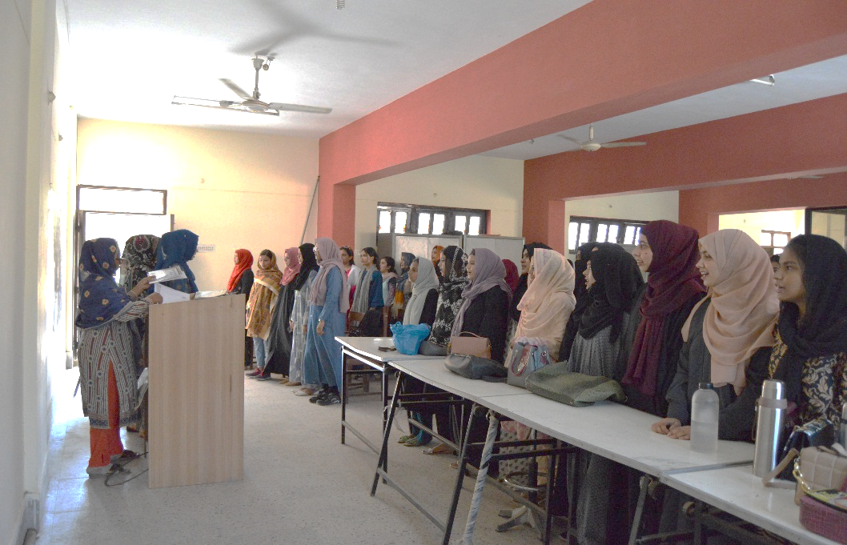
DEPARTMENT OF ARCHITECTURE
ACADEMIC ACHIEVEMENTS AWARD CEREMONY IN DEPARTMENT OF ARCHITECTURE

Slide 2
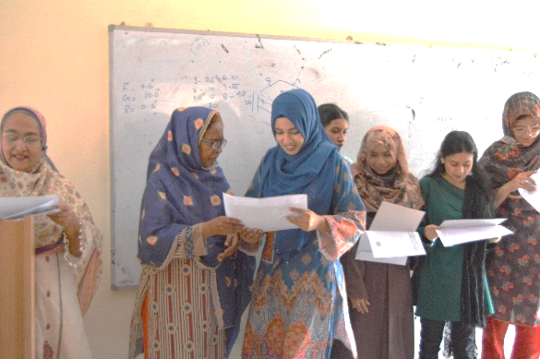
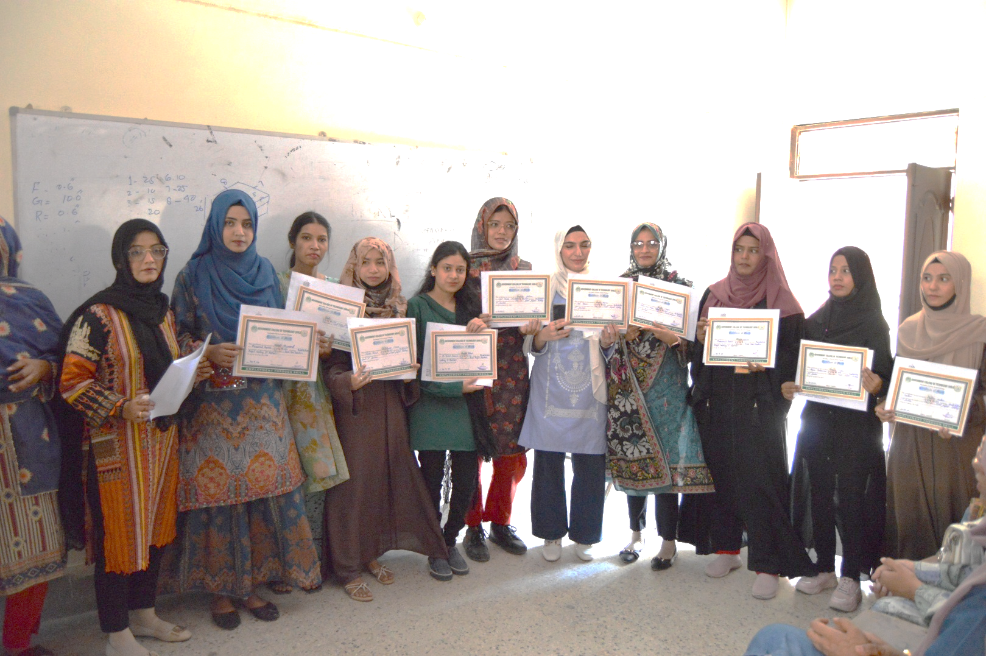
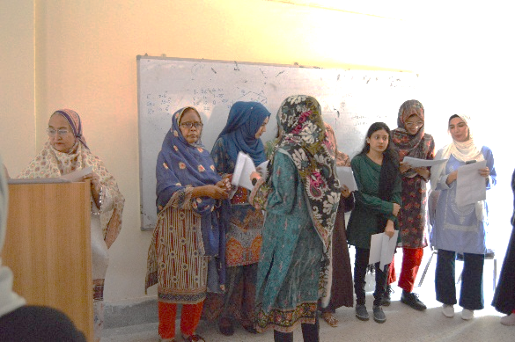
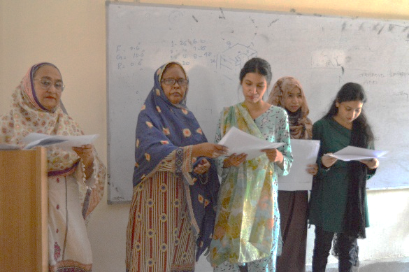
DEPARTMENT OF ARCHITECTURE
ACADEMIC ACHIEVEMENTS AWARD CEREMONY IN DEPARTMENT OF ARCHITECTURE
BATCH: 2018-2019

Slide 3
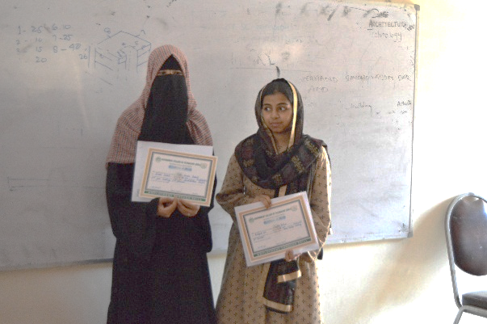
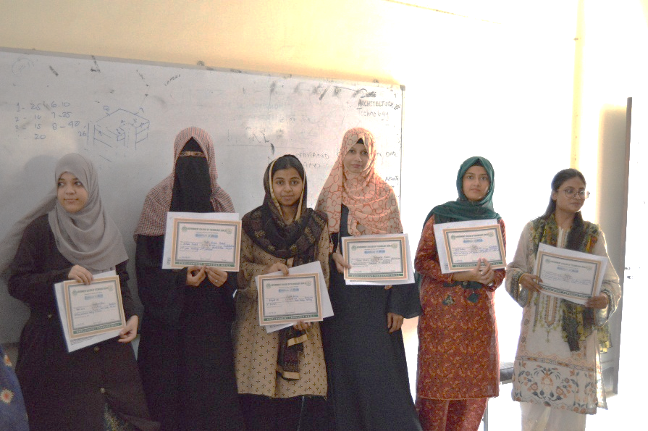

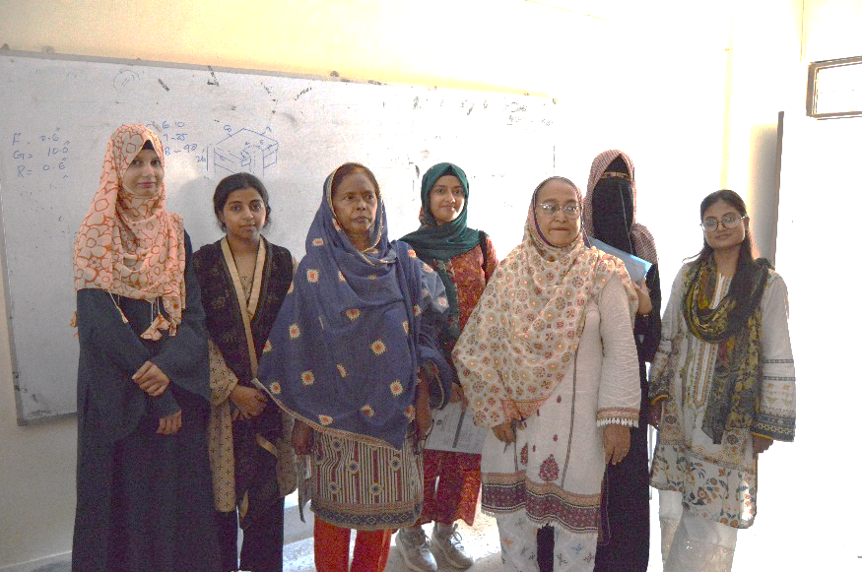
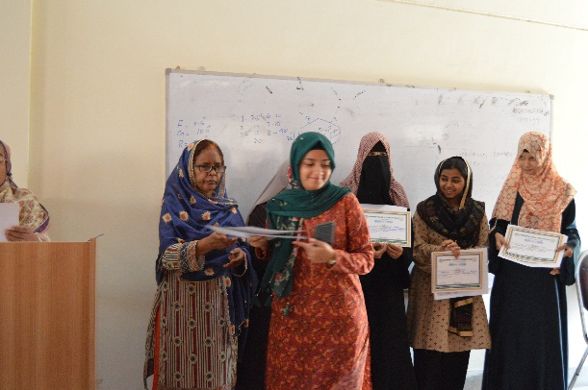
DEPARTMENT OF ARCHITECTURE
ACADEMIC ACHIEVEMENTS AWARD CEREMONY IN DEPARTMENT OF ARCHITECTURE
BATCH: 2020-2021

Slide 4
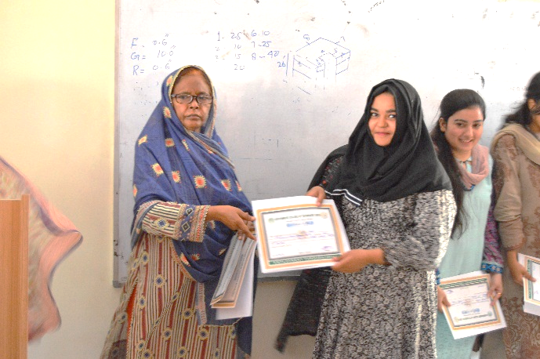
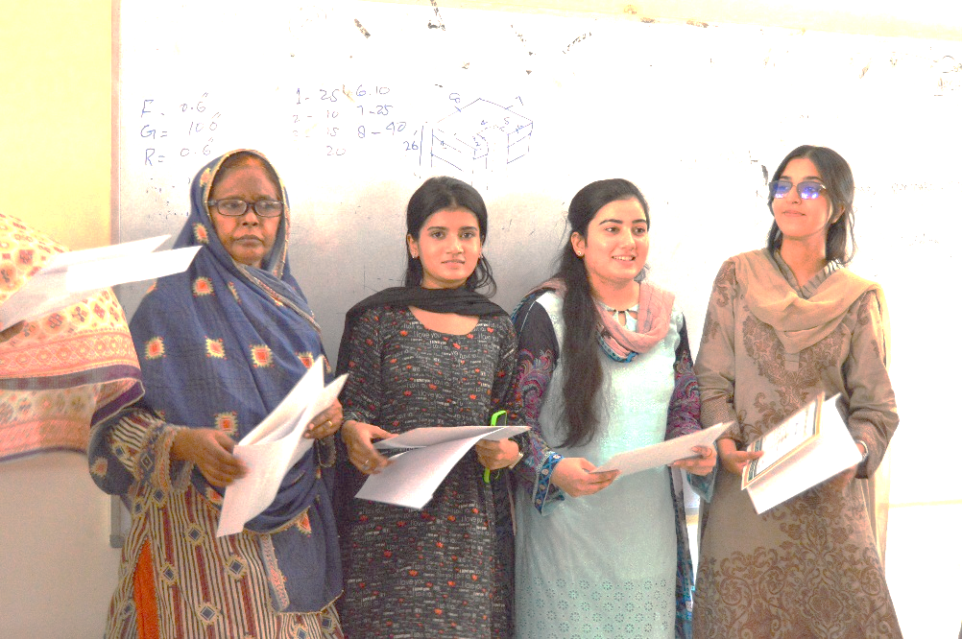

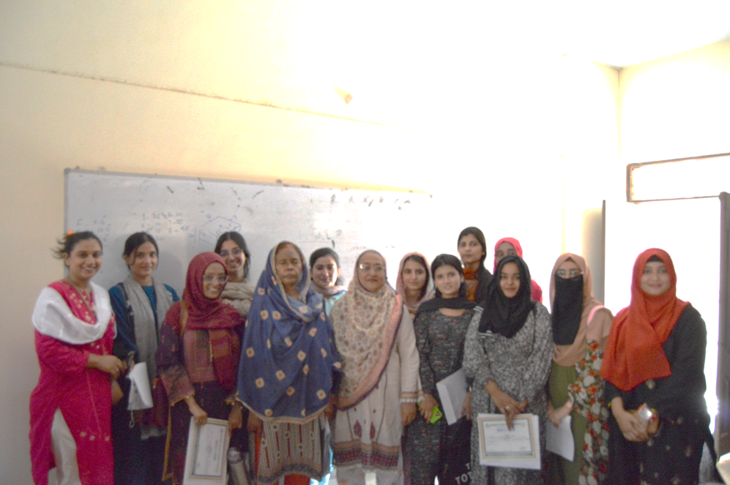
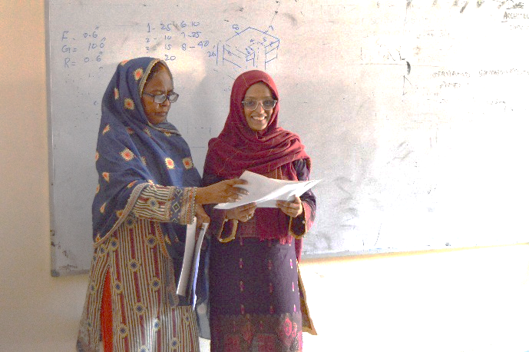
DEPARTMENT OF ARCHITECTURE
ACADEMIC ACHIEVEMENTS AWARD CEREMONY IN DEPARTMENT OF ARCHITECTURE
BATCH-

Slide 5
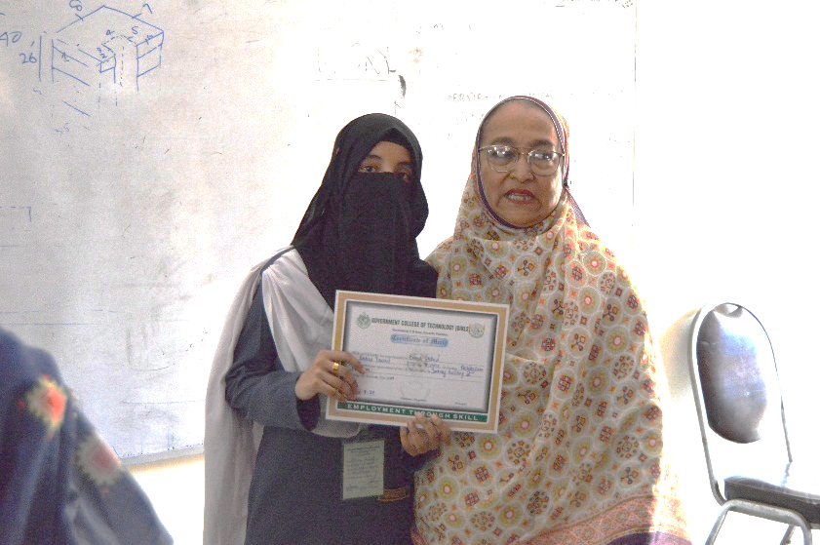
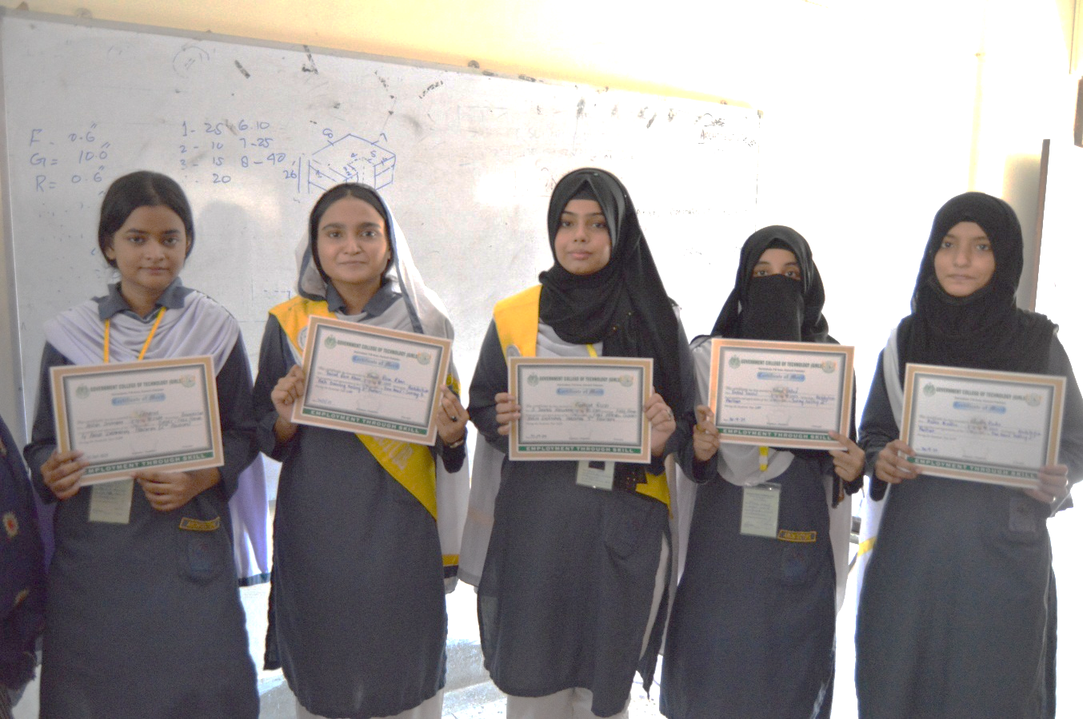
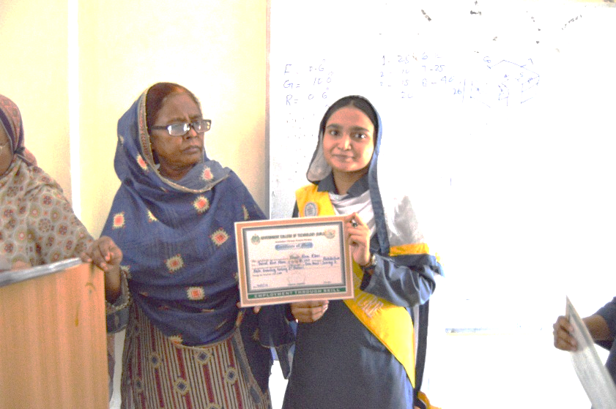
DEPARTMENT OF ARCHITECTURE
ACADEMIC ACHIEVEMENTS AWARD CEREMONY IN DEPARTMENT OF ARCHITECTURE
BATCH: 2023-2024

Slide 6
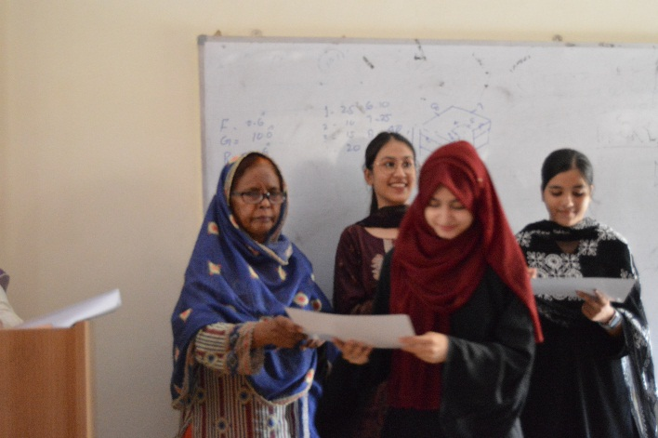

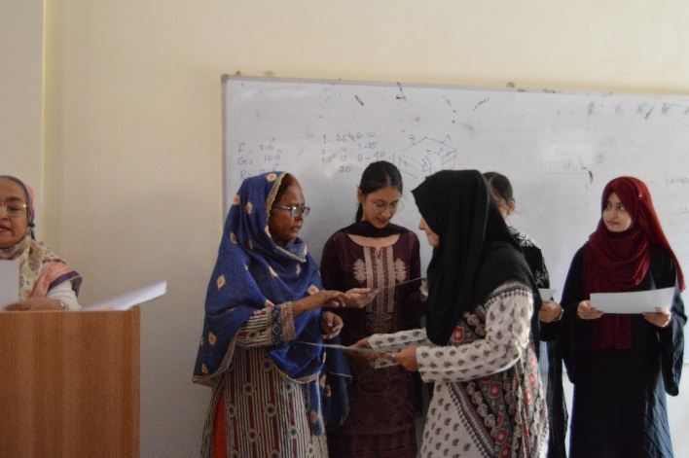
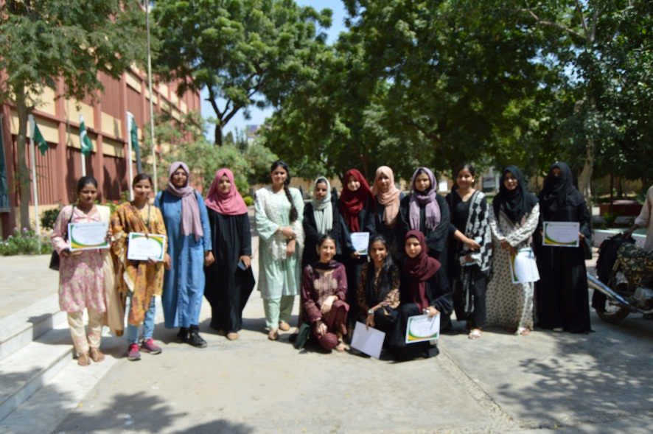
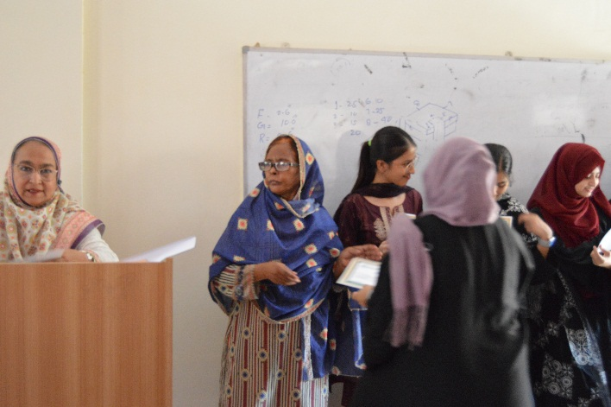
DEPARTMENT OF ARCHITECTURE
ACADEMIC ACHIEVEMENTS AWARD CEREMONY IN DEPARTMENT OF ARCHITECTURE
BATCH: 2021-2022

